Slide 1
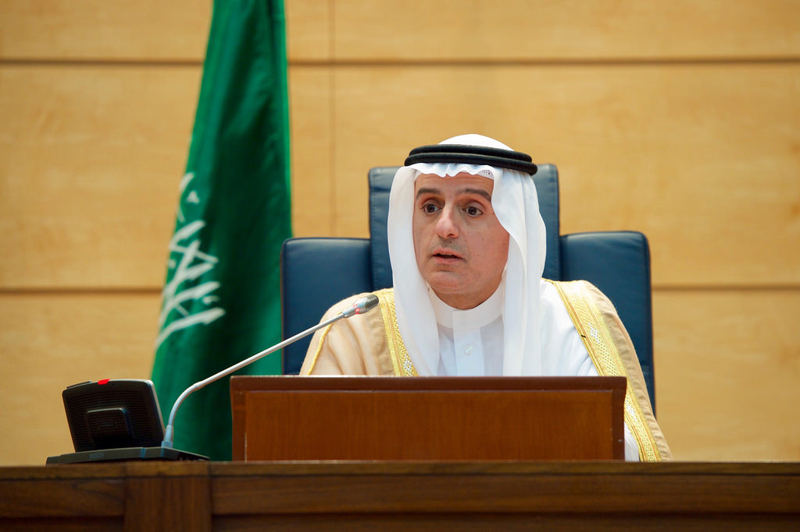
ANALYSIS OF THE LEADERSHIP COMPETENCIES OF MR ADEL BIN AHMED AL-JUBEIR
GROUP WORK

Slide 2
INTRODUCTION
This presentation examines the leadership approach and methods of Mr Adel bin Ahmed Al-Jubeir
The presentation is a compilation of the different theories of leadership which are used as different lenses to examine and review the leader of interest.
This comprehensive report examines different leadership approaches and mechanisms which are used to explain the leader’s approaches.
Each team member focused on one or a combination of leadership theories to explain the nature, success and features of Mr. Nasser’s leadership style.

Slide 3
BACKGROUND OF MR ADEL BIN AHMED AL-JUBEIR
Mr Adel bin Ahmed Al-Jubeir was born in Majmaah (Riyadh Province) on February 1, 1962.
He attended schools in Germany, United Kingdom, Lebanon, and the United States and got a B.A Summa Cum laude in political science and Economics from North Texas University and an M.A. in international relations from the University of Georgetown in 1984
Has served in the Diplomatic service and posted to the Royal Embassy of Saudi Arabia in Washington DC as a special assistant to the Ambassador.
He was a member of the GCC delegation to the Madrid peace conference, and in 1992 he was also a member of the panel to Multilateral Arms Control talks in Washington.
He served as the Advisor at the Royal court until his later appointment as Ambassador to the United States on January 29, 2007, and foreign minister in 2015

Slide 4
MAIN ACHIEVEMENTS OF MR. ADEL BIN AHMED AL-JUBEIR
Mr Al-Jubeir formeD the new Saudi Arabia image worldwide which is not bound by tradition and authoritarianism but bound by what people want and have worked to create the Saudi Arabia they are proud of.
He has played the role of steering the country and moving it toward goals and ends that guarantees win-win outcomes
Setting high expectations to challenge the people working with him
Helped all stakeholders to redefined the broader vision of Saudi Arabia's foreign policy
Encouraging people to look beyond self-interests but country’s interests.
Recognize the achievements and support all those making the effort
Integrity and fairness overall plan.

Slide 5
METHODOLOGY OF THE GROUP PROJECT
Team members were encouraged to do personal research about the leadership processes and procedures of Mr Adel bin Ahmed Al-Jubeir.
Members were encouraged to dig deeper and find information about how Mr achieved these feats
Ascertain how the theories and concepts of leadership identified in the course can be linked to the achievements of Mr. Nasser
Team members wrote their leadership analysis of Mr Al-Jubeir These contributions are presented below in the different sections below.
After submissions were made, there was a presentation of views by team members. This was a form of peer review that ensured that the submissions of team members were critiqued and this is inserted at the end of each section.

Slide 6
TRANSFORMATIONAL LEADERSHIP
Transformational Leadership | Mr Al-Jubeir
Setting organizational goals with followers | Al-jubeir got people to take part in decision making and choices
Integrating people’s goals into company goals | Al-jubeir made it clear that the future was jointly held
Motivation and great communication | Al-jubeir could summarize things and present strong inputs that people at all levels understood.
Trust and mutual respect | Al-jubeir highlighted minor gains and always used the best techniques that produced results.

Slide 7
BEHAVIORAL THEORY OF LEADERSHIP
Behaviour Theory | Mr Al-Jubeir
Great leaders are not born as leaders | He was born in a family of a diplomat
Great leaders learn and build habits | He made a conscious effort to learn and develop the right behaviour
Learning and relearning creates leadership behaviour | He learned from his ambassadorial duties in Washington, Peace keeping in Somalia and as Saudi’s Foreign Affairs minister
Leadership behaviour brings trust | People trust him because he has learnt and his leadership style brings results
Trust and cooperation brings results | His statements are credible and this erases doubts and the people just contribute to his vision.

Slide 8
GREAT MAN THEORY + BUREAUCRATIC LEADERSHIP
Great Man Theory | Mr Al-Jubeir
Supernormal | Graduated from school with extraordinary grades
Respected | Everyone recognises his achievements and his Saudi roots brings fame to him
Resourceful | Gains results and has evidence to prove it
Bureaucratic/Rational-Legal Leadership | He has always taken time to work with the management structure, cultivate it and make sure it works so well in improving and enhancing the way things are done.
Education | Trained at a leading institution
Experience | Has served the Royal family and the country with great results for almost 40 years
Ethics | Upholds the highest levels of ethics throughout career and continues to encourage high levels of ethical responsibility

Slide 9
TRAIT THEORY OF LEADERSHIP MODEL
Distal Attributes | Mr Al -Jubeir
Personality | He has a trusted personality that he has cultivated over many years
Motives | He understands what drives his diplomat work
Cognitive | He has great diagnostic abilities due to his experience
Proximal Attributes
Social Appraisal | Emotional intelligence and strong interpersonal and diplomatic skills
Problem Solving | Ability to solve technical and other related issues
Expertise/Tacit Knowledge | Credibility gained over 30 years while working at government entities and as a foreign minister
Leadership Criteria
Emergence | Great understanding of issues that come up evidenced by the Somali peace keeping, and advancement of Saudi arabia during his forign minister tenure
Effectiveness | Great input-output goal setter
Progress | Innovative on all levels

Slide 10
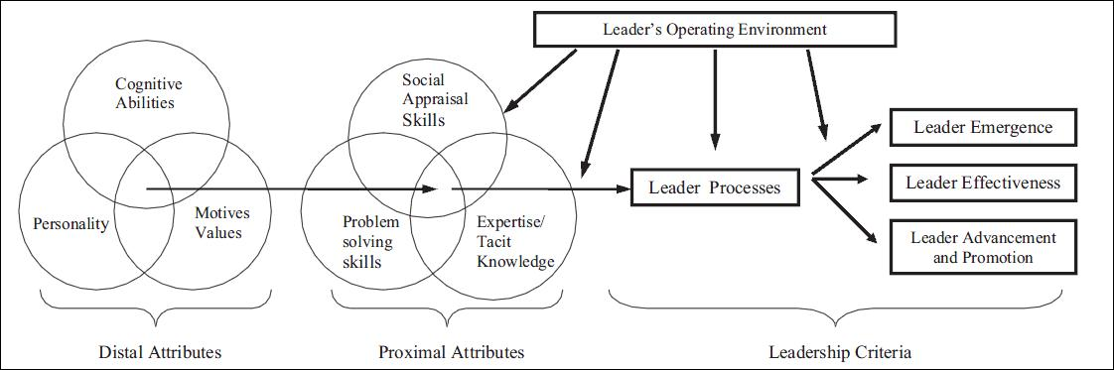
TRAIT THEORY OF LEADERSHIP ZACCARO ET AL., 2004

Slide 11
KEY LESSONS LEARNT BY THE TEAM
The group presented many different dimensions of how Mr Al-Jubeir functions as a great leader who leads its affairs and we learnt collectively that leadership is not a one-size-fits-all matter.
We also learned that there are many different dimensions of leadership, and while some might view leadership in one size, others would view it differently. Therefore, we came to respect the different perceptions and views. Each group member learnt another social

Slide 12
QUESTION & ANSWERS

Slide 13
REFERENCES
Alvinius, A. (Ed.). (2017). Contemporary leadership challenges. BoD–Books on Demand.
Bratton, J. (2020). Charismatic and Transformational Leadership. Organizational Leadership, 149.
Bright, D. S., Cortes, A. H., Hartmann, E., Parboteeah, K. P., Pierce, J. L., Reece, M., ... & O’Rourke, J. S. (2019). Principles of Management. OpenStax.
Jemielniak, D. (Ed.). (2014). The laws of the knowledge workplace: Changing roles and the meaning of work in knowledge-intensive environments. Ashgate Publishing, Ltd.

